Slide 1
For Live Session Assignment (FLS)
Unit 1

Slide 2
Philosophy
On the following slide(s) you will see activities and the estimated / expected time that the student should spend on that activity.
It is important to note that the goal of the activities is to become familiar with the methods, ideas and implementation involved in that activity so that we can efficiently iron out all the details in live session.
Analogy: You are building the pieces of puzzle in the For Live Session Activity and we are putting them together to see the big picture in live session.
It is not expected that the student have all the correct answers. The expectation is that each student spend the allotted time (indicated next to the activity) on each activity so that we can discuss the details in live session.
If you max out the indicated time without finishing the activity and you don’t have more time to finish, simply write up what you have learned by that time and record any questions you might have and we will address those in live session!
We want to develop the questions before live session so that we can use the live session time to effectively answer them!

Slide 3
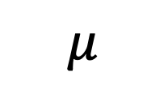

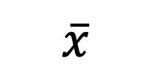


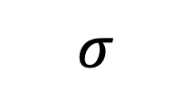
Symbols!
Standard Deviation
Mean
Variance
Sample
$$\overline{x}$$
$$s$$
$$s^{2}$$
$$μ$$
$$σ$$
$$σ^{2}$$
Population

Slide 4
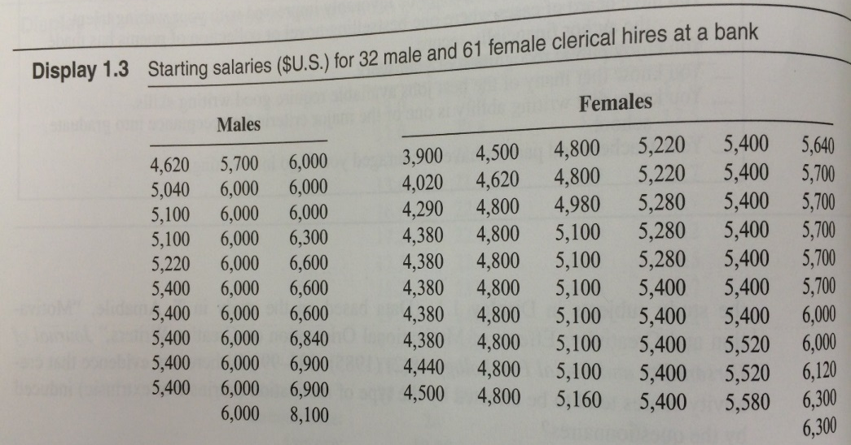
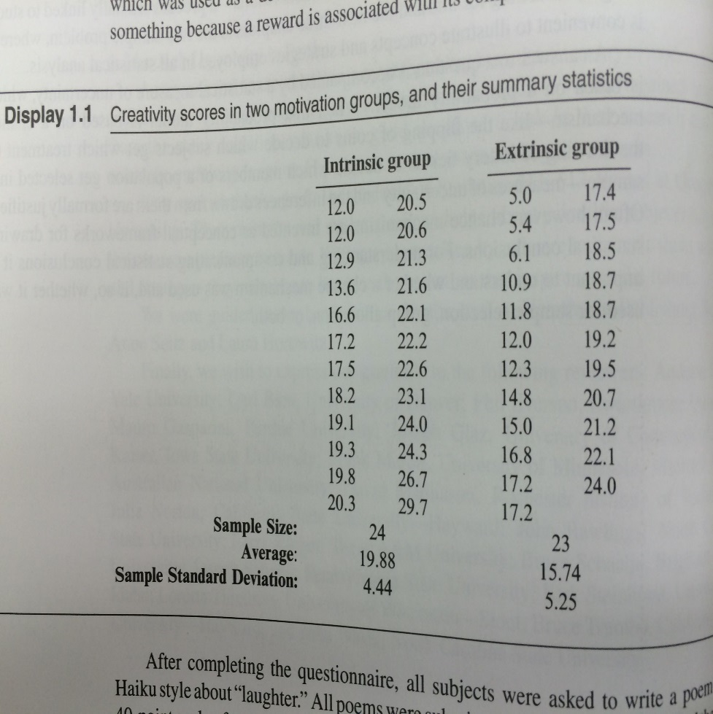
Causal Inference:
Randomized vs. Observational Study
Causal inferences can be drawn from randomized experiments
Causal inferences cannot be drawn from observational studies due to Confounding
What are some possible confounding variables in the gender/salary study?
In the starting salaries study, maybe males in this study had
more education
more seniority
more age (older)
More willingness to negotiate starting salary
Younger
oyyoyyyoyoo
oooyyyoyoyy
oyyoyyyoyooy
oooyyyoyoyy
Older
In a randomized experiment, variables like age are also randomly distributed to each group, removing the confounding effect.

Slide 5
Question 1: Quick Quiz Questions(<= 1 hour)

Slide 6
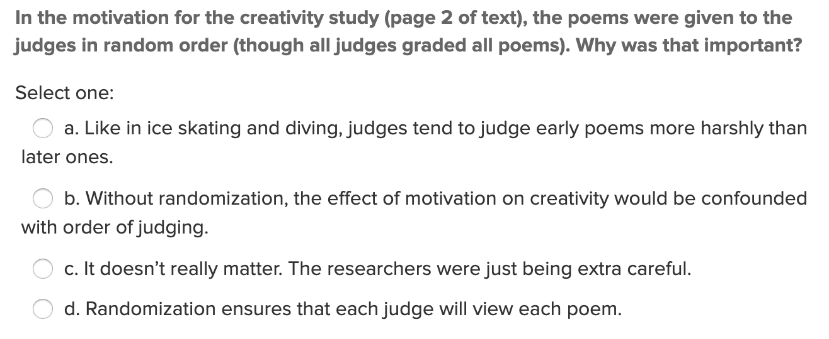
Quick Quiz Question 1 (QQ1)

Slide 7
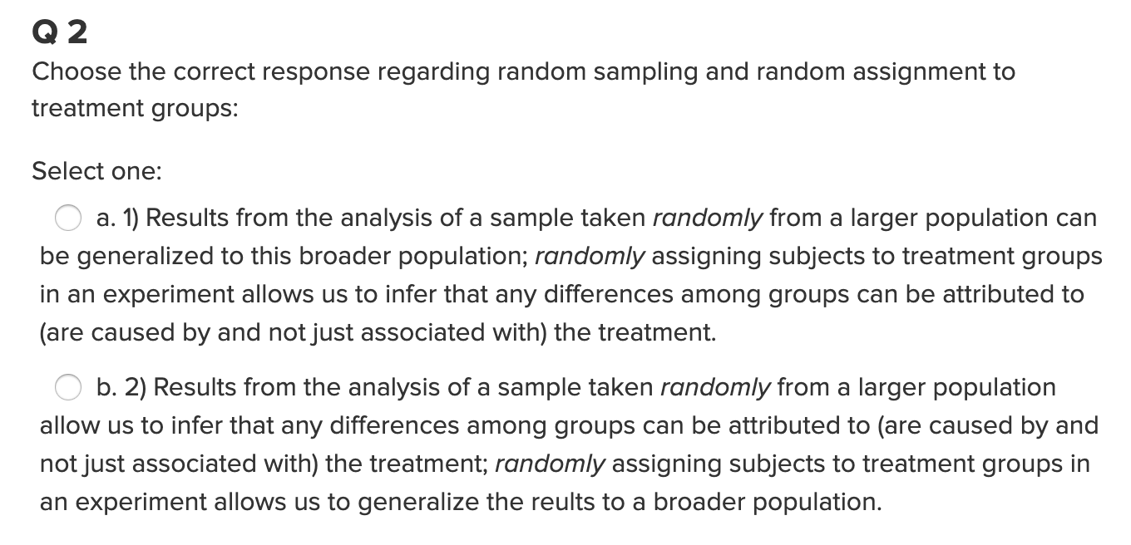
Quick Quiz Question 2 (QQ2)

Slide 8
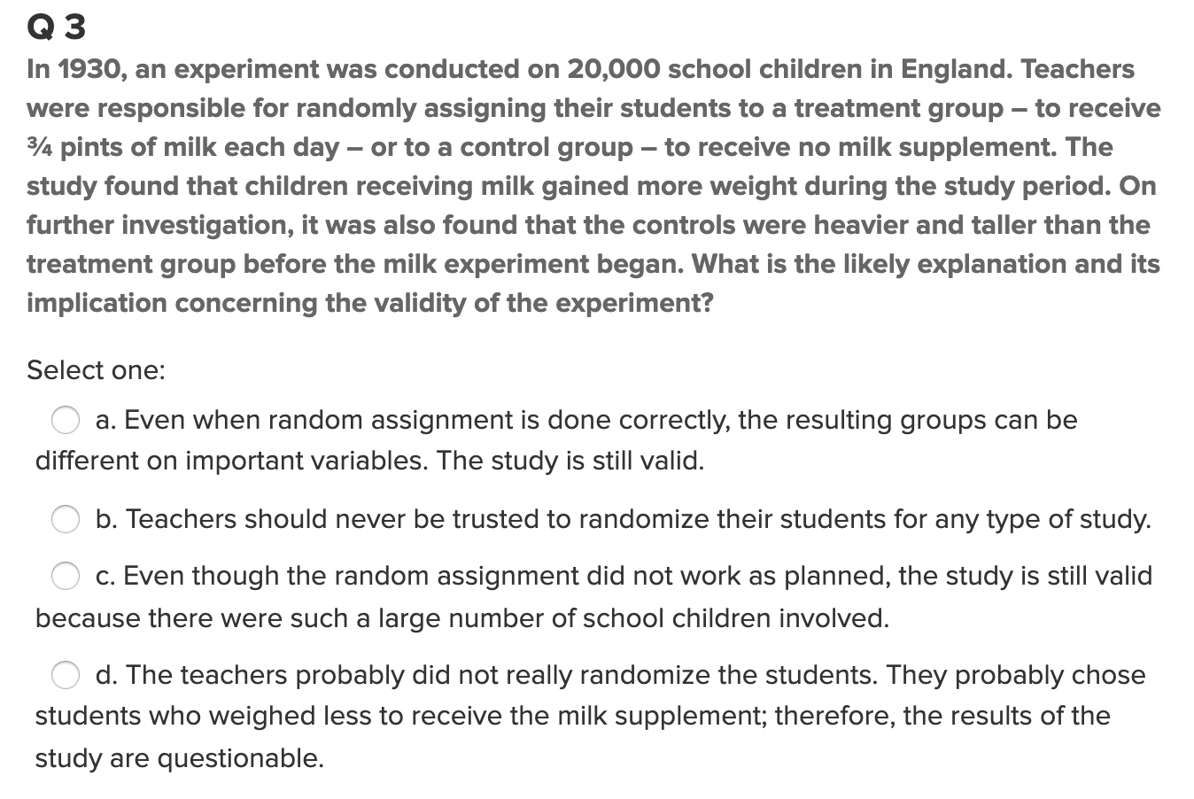
Quick Quiz Question 3 (QQ3)

Slide 9
Break Out 1

Slide 10

Question 2 ($≤1 hour)$
What is the difference between a randomized experiment and a random sample? Under what type of study/sample can a causal inference be made?

Slide 11
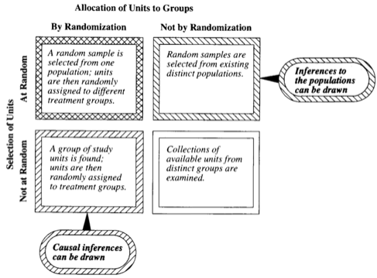
Question 2 ($≤1 hour)$
What is the difference between a randomized experiment and a random sample? Under what type of study/sample can a causal inference be made?

Slide 12

Question 3 ($1 hour)$
In 1936, the Literary Digest polled 1 out of every 4 Americans and concluded that Alfred Landon would win the presidential election in a landon-slide (pun intended:). Of course, history turned out dramatically different (see http://historymatters.gmu.edu/d/5168/ for further details). The magazine combined three sampling sources: subscribers to its magazine, phone number records, and automobile registration records. Comment on the desired population of interest of the survey and what population the magazine actually drew from.

Slide 13
End Break Out 1

Slide 14
Break Out 2

Slide 15

Question 4 ($≤$1 hour)
Suppose we have developed a new fertilizer that is supposed to help corn yields. This fertilizer is so potent that a small vial of it sprayed over an entire field is a sufficient dose. We find that the new fertilizer results in an average yield of 60 more bushels over the old fertilizer with a p-value of 0.0001. Write up a scope of inference under the following study designs that generated this data.
  We offer the new fertilizer at a discount to customers who have purchased the old fertilizer along with a survey for them to fill out. Some farmers send in the survey after the growing season, reporting their crop yield. From our records, we know which of these farmers used the new fertilizer and which used the old one.
  When a customer makes an order, we randomly send them either the old or new fertilizer. At the end of the season, some of the farmers send us a report of their yield. Again, from our records, we know which of these farmers used the new fertilizer and which used the old.

Slide 16
End Break Out 2

Slide 17
Break Out 3

Slide 18

Practice with Scope: Q1
A particular study focused on high school freshman and seniors and their GPAs in a required economics class. The study consisted of enumerating every freshman and senior in the school and randomly selecting them from that sampling frame. Their scores in the economics class were then recorded, and a hypothesis test for the difference of means was conducted. The seniors were found to have a significantly greater mean score in the class than the freshman. What sort of conclusions can be made from this study? In other words, what is the scope of this study? In this class, scope typically constitutes both the causal inferences and populations inferences.

Slide 19
Practice with Scope: Q2
The Navy is very interested in the effects of sleep deprivation on cognitive ability. In order to test the effect, the Navy put out a radio advertisement asking for 18 to 35 year old nonsmokers to participate in the study. The volunteers were then placed in either the control group (no sleep deprivation) or the treatment group (36 hours of sleep deprivation) based on the flip of a fair coin (Heads = Control, Tails = Treatment). After the data was collected, the sleep deprived group was found to have a significantly lower mean math score than the group not deprived of sleep. What sort of conclusions can be made from this study? In other words, what is the scope of this study (causal inferences and population inferences)?

Slide 20
End Break Out 3

Slide 21
Break Out 4

Slide 22
Question / Activity 5 (2-3 hours)
With respect the Creativity Study you read in the Statistical Sleuth, use the code provided to conduct a permutation test to test for a difference in mean score between those motivated intrinsically and extrinsically.
Recommended approach:
  Reread the material in the book and really think about it.
  Review the code provided and run it a few times … try to make sense of the output and how it is generated.
  Check out the video resource that fully explains the code.
  Bring your questions to Live Session and place them at the end of the powerpoint deck.

Slide 23
End Break Out 4

Slide 24
Activity 6: For Discussion in Live Session
Please check out this 4 min podcast!
We will discuss in class! ☺
https://one.npr.org/?sharedMediaId=nx-s1-5928263:nx-s1-9889578

Slide 25
Question 7: Takeaways! (~ 1 Hour)
Please provide at least 4 takeaways from this section and any questions that you may have. These questions will help design the live session for this unit.
This question will be the last question of every For Live Session Assignment. The idea is that this deck will serve as a document that you can reference in the future to remember what was covered in this section. For instance, this may come in handy for the Capstone and will hopefully become useful in your career. Most immediately, it may become handy as a quick reference for your Midterm and Final! Some students find it very useful and spend a few slides summarizing the asynch material while others learn different ways and only had the minimum 4 takeaways. Either is fine and will earn you full credit for this question.

Slide 26
Question 8: Questions!
Please provide any question or topics of discussion that came up in this Unit! These will help help us optimize our live session for maximum learning and takeaways!
This question will be the last question of every For Live Session Assignment. The idea is that this deck will serve as a document that you can reference in the future to remember what was covered in this section. For instance, this may come in handy for the Capstone and will hopefully become useful in your career. Most immediately, it may become handy as a quick reference for your Midterm and Final! Some students find it very useful and spend a few slides summarizing the asynch material while others learn different ways and only had the minimum 4 takeaways. Either is fine and will earn you full credit for this question.

Slide 27
End of For Live Session: Unit 1

